Slide 1

board of county commissioners overview of functions & budget
September 12, 2018

Slide 2
Building department
(1 Director & 5 full time employees)
Office Overview – Administers and enforces Florida Building Codes, Florida Fire Prevention Code, and the County Code; and issues building permits.
Performance Measures from 10/1/17 – 8/29/18
  Single Family Dwelling Permits = 256
  Commercial Permits = 6
  Permits Issued = 1,865
  Inspections = 14,109
  Plan Reviews = 583

Slide 3
Communications & public Services Department
(1 director and 2 full time employees)
Office Overview – Coordinates and creates the BOCC Agenda’s; prepares news releases; maintains County website and County Facebook page; processes Committee meeting notices; and manages public records requests.
Performance Measures from 10/1/17 – 7/31/18
  Board Meetings = 18
  Agenda Items = 324
  Special Meetings = 3
  Workshops = 6
  Public Records Requests = 109
  Committee Meetings Noticed = 54

Slide 4
Library services
(within the Communications & Public Services Department)
(1 Director, 5 full time employees, & 1 part time employee)
Office Overview – Provides access to books, videos and audio books, internet access, and programs for children and adults
Performance Measures from 10/1/17 – 7/31/18
  Registered Borrowers = 10,100
  Circulation = 60,223
  Adult Programs = 584
  Children’s Programs = 241
  Total Program Attendance = 12,458
  Public Computer Users = 6,669

Slide 5
Recreation department
(within the communications & public services department)
(1 director, 3 full time employees, & 1 Part time employee
Office Overview – Provides sports programs, oversees maintenance of the Recreation Park fields and the Equestrian Center.
Performance Measures 10/1/17 to 7/31/18
  Youth Basketball Participants = 56; Events = 39
  Winter Soccer Participants = 431; Events = 369
  T-Ball Participants = 133; Events = 80
  Pitching Machine Participants = 59; Events = 72
  Player Pitch Participants = 26; Events = 46
  Cal Ripken League Participants = 88; Events = 57
  Babe Ruth League Participants = 44; Events = 17
  Girls Softball Participants = 184; Events = 78
  Adult Softball Participants = 165; Events = 65
  Flag Football Participants = 79; Events = 72
  Tackle Football Participants = 282; Events = 58
  Summer Sports Camp Participants = 60
  Community Center Program Participants = 1,550 (Open gym, basketball, Zumba, Line Dancing, & Yoga)

Slide 6
Veteran services office
(Within the Communications & Public Services Department)
(1 full time employee)
Office Overview – Provides support and needs to Veterans, spouses, and dependents.
Performance Measures from 10/1/17 – 7/31/18
  Veterans who signed in = 161
  Active Files = 1,165
  Inactive Files = 2,184

Slide 7
Employee support services department
(1 director & 1 full time employee)
Office Overview – Responsible for all matters pertaining to personnel; risk management; P-Card Program; Fuel Card Program; County Cell Phones; and Information Technology.
Performance Measures from 10/1/17 – 8/31/18
  Total of BOCC Staff = 95
  New Hires = 63
  Terminations = 47

Slide 8
Extension office
(1 Director, 3 full time employees, & 1 Part time employee )
Office Overview – Provides information in the areas of agriculture, horticulture, natural resources, family and consumer sciences, marine, and youth development.
Performance Measures from 10/1/17 – 7/31/18
  Ag/Natural Resources/Horticulture/Master
    Educational Materials Prepared = 206
    Field Contacts = 131
    Office Consultations = 868
    Telephone Consultations = 2,798
    E-Mail Consultations = 2,128
    Group Learning Participants = 1,187
    Volunteer Hours = 7,238
  Family & Consumer Services
    Educational Materials Prepared = 38
    Field Contacts = 447
    Office Consultations = 16
    Telephone Consultations = 207
    E-Mail Consultations = 450
    Group Learning Participants = 510
    Web Page Visits = 74,694
    Volunteer Hours = 55

Slide 9
Extension Office cont’d
4-H & Youth Programs
  Field Contacts = 160
  Office Consultations = 230
  Telphone Consultations = 192
  E-Mail Consultations = 591
  Group Learning Participants = 19
  Social Media Contacts = 81,030
  Volunteer Hours = 321

Slide 10
Fiscal Operations Department
(1 Director & 1 Full Time Employee)
Office Overview – Responsible for monitoring all County revenues and expenses; prepare annual budget; coordinates all procurement functions; processes grant reimbursement request; manages all County contracts/agreements.
Performance Measures from 10/1/17 – 7/31/18
  Procurement:
    Competitive Procurements Issued = 25
    Competitive Procurements Awarded = 22
  Contract Management:
    Managing 62 Open Contracts (Including Grant Agreements, Construction Agreements, Work Authorizations, & Continuing Services Agreements)
  Fiscal Operations:
    Reviewed & Approved 10,320 Financial Board Obligations (P-Card Transactions, Disbursement Requests, & Monthly Draws)
    Monitoring 1,057 Active Budget Line Items
    Preparing Budget for FY2018/19 of 1,100 Budget Line Items

Slide 11
intergovernmental affairs and restore act department
(1 director & 1 Full Time Employee)
Office Overview – Serves as liaison for the Adopted Infrastructure Plan, BP Oil Spill (RESTORE Act, Triumph Gulf Coast, NRDA Projects), Bike Trails, Economic Development, Federal & State Grants and Programs, and Federal & State Legislative Affairs.
Performance Measures from 10/1/17 – 7/31/18
  Grants Applied For = 20
  Grants Awarded = 7
    Totaling $8,177,048.00
  Grants Pending = 4
    Totaling $7,318,275.84

Slide 12
Parks & facilities management department
(1 Director, 7 Full time employees, & 1 Part time employee)
Office Overview – Provides a variety of activities at County parks; processes rentals of parks and facilities; maintains all parks, boat ramps/water way signage, and County facilities; and serves as project management of current projects (i.e. new Fire Station, Mashes Sands renovations, Community Center FRDAP Grant, and Woolley Park walking trail).
Performance Measures from 10/1/17 – 7/31/18
  Parks Maintained = 8
  Boat Ramps Maintained = 10
  Buildings/Facilities Maintained = 52

Slide 13
Planning & community development department
(1 Director, 4 full time employees)
Office Overview – Provides current and long-range comprehensive planning, subdivision and site plan review, concurrency management, zoning and land use administration and implementation; manages housing services and code enforcement; other special projects include floodplain management, community rating system, evaluation and appraisal reports to the comp plan, serves as staff liaison on seven committee’s, and implementation and development of the Crawfordville Town Plan.
Performance Measures 10/1/17 – 7/31/18
  Planning & Zoning Applications Processed
    Development Permit Applications = 672
    Local Business Tax Receipts = 117
    Commercial Site Plans = 32
    Minor Lot Splits = 19
    Change of Zoning = 16
    Temporary Use Permits = 13
    Mobile Food Vending Permits = 7
    Variance Requests = 7
    Comprehensive Plan Future Land Use Map Amendments = 5
    Family Enclaves = 4
    Family Homestead = 4
    Road Closings = 4
    Preliminary Plats = 4
    Final Plats = 4
    Conditional Use Permits = 3

Slide 14
Planning & community development department cont’d
Code Enforcement Service Outputs
  Case Files Processed = 167
  Cases Presented to Code Enforcement Board = 19
  Lien Reduction Applications = 5
  Code Violation Search Requests = 182

Slide 15
Probation Services
(1 director & 1 full time employee)
Office Overview – Provides probation supervision, intensive supervision, deferred prosecution supervision, house arrest, electronic monitoring and chemical testing to defendants ordered by County or Circuit Judge.
Performance Measures from 10/1/17 – 7/31/18
  Active Case Files = 1,415
  New Case Files = 253
  Violation of Probation = 123
  Total Case Load = 3,928
  Scheduled OV’s = 887
  Walk-Ins = 567

Slide 16
Public safety department
(1 director, 32 full time employees, 18 Flex/On call, 16 certified volunteer firefighters)
Office Overview – Provides advanced life support, emergency patient transport, fire suppression, rescue, and vehicle extrication services. Career staff work 3 shifts, 48 hours on, 96 hours off.
Performance Measures 8/22/17 – 8/22/18
  Fire/EMS Services (10 Stations)
    EMS Response = 4,161
    Fire Response = 3,752
    Times Out of Ambulances = 83

Slide 17
Animal services
(within the public safety department)
(1 Director, 3 full time employees, & 4 part time employees)
Office Overview – Protects the public and animals health and safety; promotes pet ownership, compassion, and education.
Performance Measures from 10/1/17 – 7/31/18
  Surrendered = 379
  Seized = 220
  Stray = 527
  Adopted = 219
  Reclaimed = 183
  Rescue = 638
  Euthanized = 114 (34 were owner requested)
  Calls For Service = 1,535
  Bites to Humans = 86
  Return to Owner = 15.4%

Slide 18
Public works – road & bridge, & Fleet Management
(1 director, 18 full time employees, & 1 part time employee
Office Overview – Oversees maintenance & repair of all County Roads and Bridges; and fleet management oversight.
Performance Measures
  County Roads:
    Total Maintained County Roads = 781
    Maintained Dirt Roads = 241 miles
    Right-Of-Way Mowing = 483 miles
  County Bridges:
    Total Maintained County Bridges = 24
  Fleet Management:
    Maintains & Repairs all BOCC Vehicles, small equipment, heavy equipment, processes orders for new vehicles & equipment; and inventory management.

Slide 19
Revenue collections department
(1 director & 1 full time employee)
Office Overview – Responsible for collecting EMS, Sewer, & Water revenues. Special projects include right-of-way donations, manages FEMA process, Waste Pro liaison, and Solid Waste Grant Management.
Performance Measures from 10/1/17 – 7/31/18
  EMS Billing & Collection - $1M Collected
  Sewer & Water Billing & Collection – Approx. 1,000 customers billed monthly

Slide 20
Tourist Development
(1 full time employee)
Office Overview: Responsible for the operations and marketing functions of the Wakulla County Tourist Development Council (TDC). Serves as a spokesperson while working with committees, organizations and individuals whose work and purposes affect the tourism in Wakulla County; and is responsible for coordinating tourist development programs and activities to bring new dollars to the County by generating leads for group travel, events and individual travel; with a primary focus on nature-and heritage-based tourism.

Slide 21
questions???

Slide 22
Local government Budget fundamentals

Slide 23

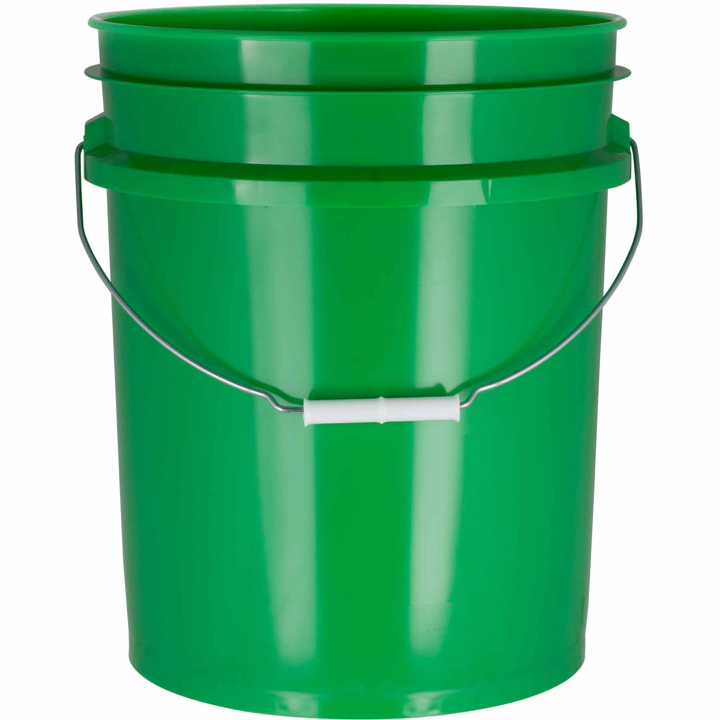
Total Countywide budget
76.6 million dollars in one large bucket

Slide 24
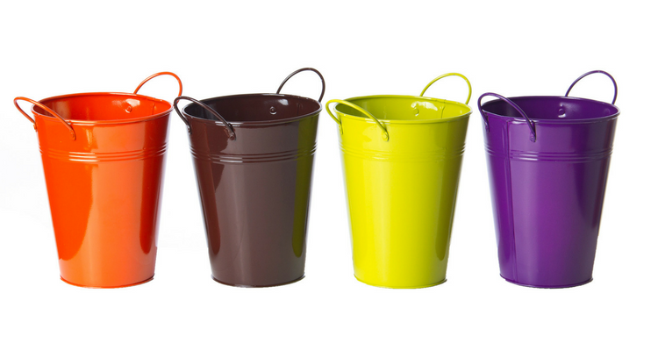
The large bucket includes…
Four more medium buckets!
General Fund – 26.2M
Restricted Funds – 19.7M
Construction Funds – 12.2M
Business Funds – 18.5M

Slide 25
Each bucket is unique
Each one has a specific purpose and is managed carefully to make sure money spent from them is suitable to its purpose.
Of the four, only one can be used for general government operations such as salaries, utilities and office supplies but everything spent from ALL buckets must be for a public purpose.

Slide 26
Inside those four buckets…
There are 22 major funds that may or may not have sub funds within.
There are 60 sub funds totaling 82 individual funds that are constantly monitored.

Slide 27
General fund bucket – 26.2M
Includes things like property tax, PST, state revenue sharing, departmental revenue and transfers in from other funds.
Pays for staff wages and benefits, electricity, telephone and internet, paper and office supplies, and other general government needs.
Of this bucket, 9.6M is used to operate the BOCC departments. That 9.6M includes 1M “reserve” for unanticipated expenses or to be saved.
Includes funding 12.4M for the Clerk of Court, Property Appraiser, Sheriff, Supervisor of Elections, and Tax Collector. In addition, this bucket includes 2.8M of “duplicate” dollars due to the structure of the transfer of cash to each Constitutional Officer.

Slide 28
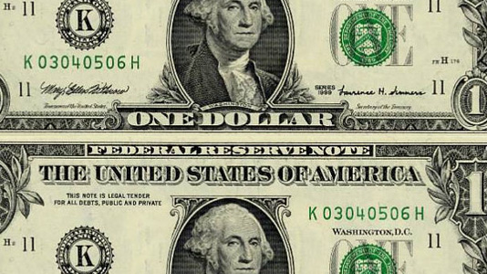
“duplicate” dollars?????
Husband and Wife are happily married with separate bank accounts. Husband made $500 this week and deposited it in his account. He writes Wife a check for $500. Wife deposits the check from Husband in her bank account. Wife spends $500 on household bills. Husband and Wife have each recorded a deposit (revenue) and a debit (expense) to their separate bank accounts but it is the same $500.
The double counting effect is most prevalent in the General Fund but occurs any time there is a transfer out of one bucket to another.

Slide 29
Restricted funds bucket – 19.7M
Revenue here varies but includes fees collected from user fees for things such as sports at the recreation park and boat ramps, grant funds, fuel taxes, service assessments, and court fees.
Pays for operations, maintenance and repair, housing rehabilitation, fire protection services, education, training, and communication services.
The Sheriff’s 12.1M and Fire Protection 1.7M fund are both inside this bucket.

Slide 30
Construction Funds bucket – 12.2M
This contains things like grant funds, all remaining impact fees and One Cent Sales Tax.
Expenses suitable here must be a project or equipment that costs at least 5K such as a vehicle, road resurfacing and construction projects, or rehabilitation of a county facility.
With impact fees specifically, projects must add capacity to county facilities and can only fund the portion of the project that equates the same factor of population increase.

Slide 31
Business funds bucket – 18.5m
All the revenue that goes in here is the result of a fee or assessment for a specific service such as providing water, access to wastewater treatment, and weekly trash pick up. There is also grant funding included to improve the infrastructure of the county wastewater treatment system.
This pays for maintenance, repair and operations of the water plant, wastewater treatment system, new infrastructure, and paid to Waste Pro to provide weekly service.

Slide 32
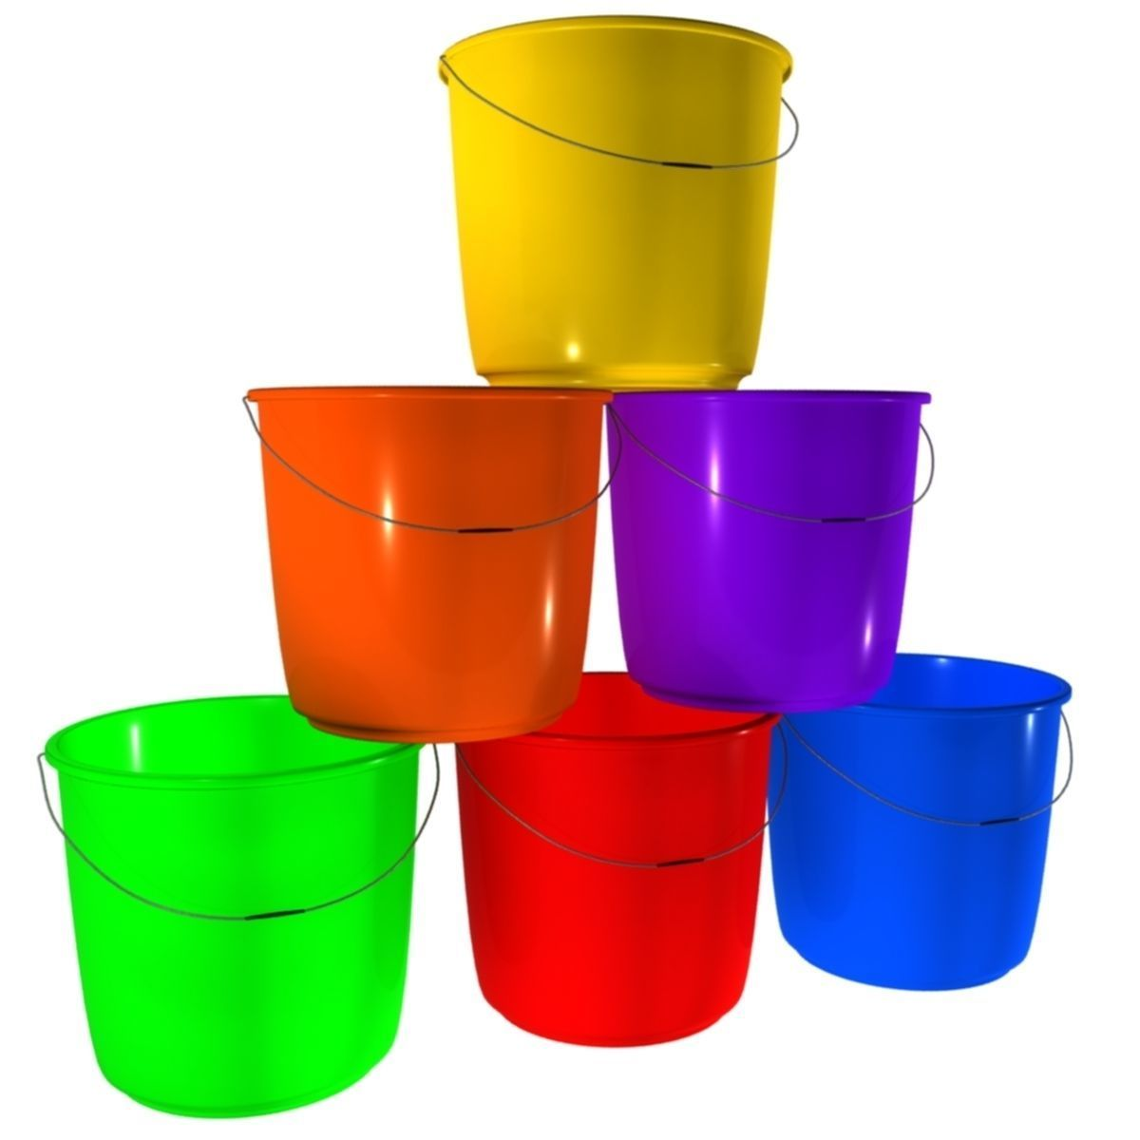

And inside each of those buckets???
Many smaller buckets! The smaller buckets are also special and establish the collection and spending parameters for staff managing all county operations.

Slide 33

General fund buckets
The small buckets in here include all the BOCC departments such as planning, parks, recreation, administration, library, probation, facilities management, animal services, emergency medical service, collections, extension, and veteran services. Some of the functions are required of the government and some are offered as amenities to improve quality of life.
Some departments listed have revenue they are responsible for collecting, such as planning, and some are cost free to citizens such as veteran services.
If they do collect revenue, it is placed in the department for use on salaries, supplies, or other use with a public purpose.
Each Constitutional Officer also has their own bucket within the General Fund.

Slide 34
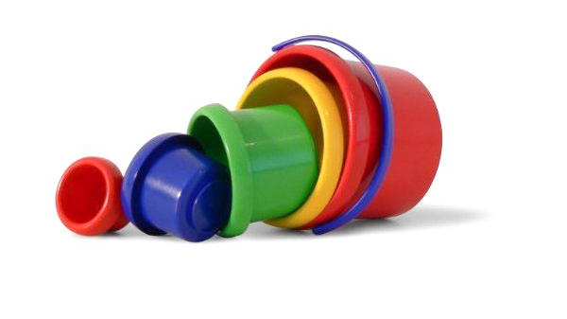
Restricted funds buckets
Small buckets in here include justice assistance grants, recreation sports, health department grants, boat ramp operations, housing initiatives, disaster assistance, court facility and crime prevention, law library, legal aid, criminal justice education, road and bridge operations, fire protection services, tourist development, and E-911 fees and grants.
These can be used for varied expenses like salaries and supplies as long as the expense serves a public purpose.
BUT, they can only be used inside their own bucket. Example: the road department can only pay for things related to road operations, and tourist development can only pay for things that further the tourist development mission.

Slide 35
Construction funds buckets
Small buckets in here include individual capital project grants. The remaining impact fees for corrections, library, and roads each have a unique bucket. There are four buckets for the separation of the One Cent Sales Tax, and nine individual buckets for FDOT road projects.
These can only be used for construction and capital equipment over 5K with a public purpose.
And just like the restricted funds, they can only be used inside their own bucket. Example: the library can only pay for things related to library improvements, and FDOT grant funds can only pay for the road project FDOT provided it for.

Slide 36
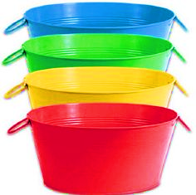
Business funds buckets
The small buckets in here include Otter Creek Wastewater Treatment Plant, Riversink Water Plant, and solid waste service. Each collects revenue specific to the service it provides either through a monthly user fee or annual assessment.
Riversink water revenue is only spent on operations and maintenance of the water system.
Wastewater revenue is only spent on operations and maintenance of the treatment system.
Solid waste revenue is spent on the landfill closure loan payment and Waste Pro for the service they provide.
These buckets should only spend what they collect, functioning like a business with the goal to keep fees at a level that any profit made is insignificant.

Slide 37
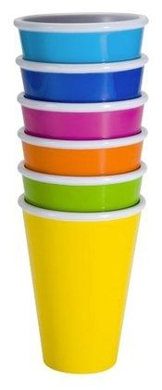
The buckets are filled with cups
Each individual budget line item has its own cup. Buckets can have as few as 2 cups (one revenue line and one expense line) or an unlimited number of cups
Each cup aslo serves a unique purpose and should only be used for that purpose
There are 1,057 active line items in the current year and over 1,100 in the FY18/19 budget

Slide 38
Managing buckets and cups
There are many unique rules to government accounting versus accounting for non-public entities. These rules are in place to protect public funds and increase accountability in their use.
The buckets and cups are managed by reviewing all transactions before they are placed into or taken out of the cup. Each cup has a unique four segment code that corresponds to the cup it belongs in, similar to a street address getting mail to it’s destination.
Transactions are reviewed individually three times before they are processed. A major focus of the review is ensuring the public purpose exists.
Transactions are also reviewed after they are entered in the accounting system for accuracy and can be moved to a different bucket or cup if that is determined necessary.

Slide 39
Big green bucket with 76.6M
Back to the first big bucket, the picture here represents the different types of revenues and the category of government those revenues are used to support. Government follows a uniform chart of accounts established by the State so all government entities account for things in the same manner.

Slide 40

the four buckets again

Slide 41
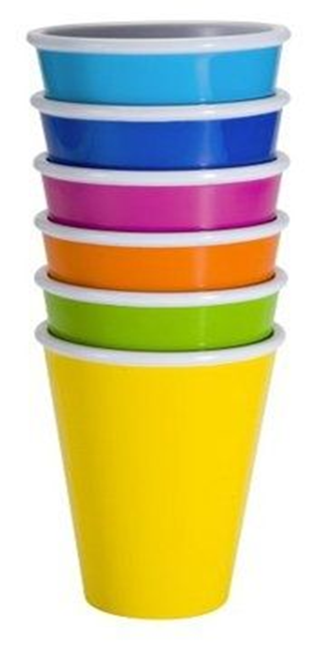
And now the cups!

Slide 42

Questions???

